Slide 1
Concurrency
Prepared by: Lec Tasmiah Tamzid Anannya, CSE Dept, MIST

Slide 2
Introduction
Java is a multi-threaded programming language which means we can develop multi-threaded program using Java.
A multi-threaded program contains two or more parts that can run concurrently and each part can handle a different task at the same time.
In simple words, concurrency is the ability to run several programs or several parts of a program in parallel.

Slide 3
Introduction
The backbone of java concurrency are threads.
A thread is a lightweight process which has its own call stack, but can access shared data of other threads in the same process.
A Java application runs by default in one process but within a Java application you can work with many threads to achieve parallel processing or concurrency.

Slide 4
Why Multithreading?
Better utilization of a single CPU.
Better utilization of multiple CPUs or CPU cores.
Better user experience with regards to responsiveness.
Better user experience with regards to fairness.

Slide 5
Multitasking
Process-based Multitasking (Multiprocessing)
Each process has an address in memory. A process is heavyweight.
Cost of communication between the process is high.
Switching from one process to another requires some time for saving and loading registers, memory maps, updating lists, etc.
Thread-based Multitasking (Multithreading)
Threads share the same address space.
A thread is lightweight.
Cost of communication between the thread is low.

Slide 6
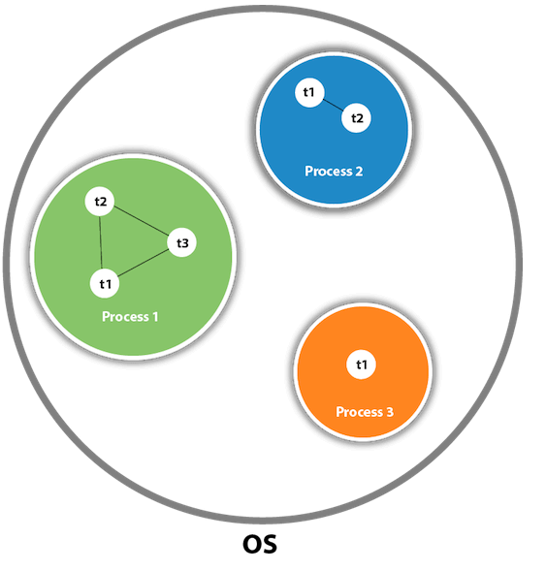
What is Thread in java
A thread is a lightweight subprocess, the smallest unit of processing.
Threads are independent. If there occurs exception in one thread, it doesn't affect other threads.
Picture Taken from: javapoint.com

Slide 7
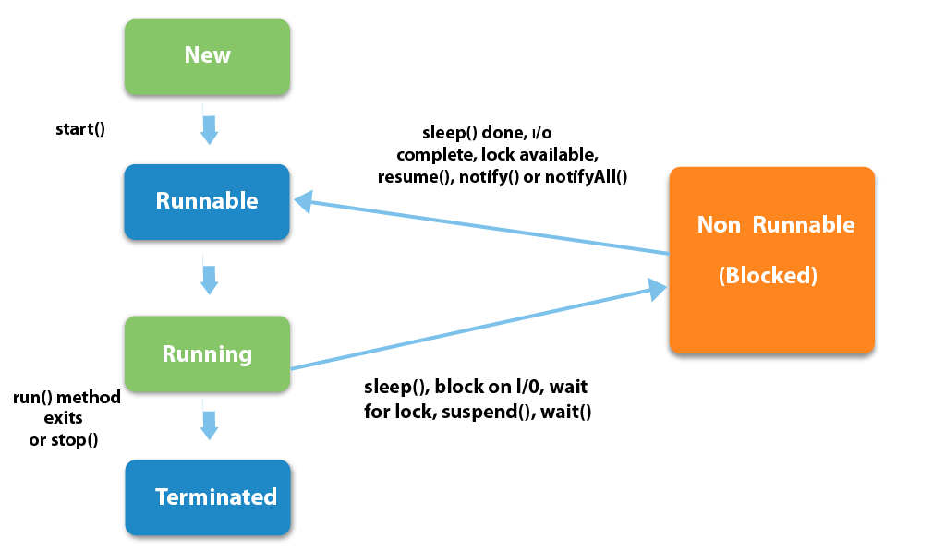
Life cycle of a thread
Picture Taken from: javapoint.com

Slide 8
Java Thread
When a Java application is started its main() method is executed by the main thread - a special thread that is created by the Java VM to run your application.
From inside your application you can create and start more threads which can execute parts of your application code in parallel with the main thread.
How to create thread
By extending Thread class
By implementing Runnable interface.

Slide 9
Create a Thread by Extending a Thread Class
1. You will need to override run( ) method available in Thread class.
public void run()
You will put all your business for the thread in this method.
2. Once Thread object is created, you can start it by calling start() method, which executes a call to run( ) method.
A new thread starts(with new callstack).
The thread moves from New state to the Runnable state.
When the thread gets a chance to execute, its target run() method will run.

Slide 10
Create a Thread by Implementing a Runnable Interface
1. As a first step, you need to implement a run() method provided by a Runnable interface.
public void run()
2. As a second step, you will instantiate a Thread object using the following constructor-
Thread(Runnable threadObj, String threadName);
3. Once a Thread object is created, you can start it by calling start() method, which executes a call to run( ) method

Slide 11
Functions provided by Thread Class
setName(String name)
getName()
getID()
currentThread()
sleep(long milisecond) throws InterruptedException
join() throws InterruptedException
setPriority(MIN_PRIORITY, MAX_PRIORITY, NORM_PRIORITY)

Slide 12
synchronized keyword
When we start two or more threads within a program, there may be a situation when multiple threads try to access the same resource and finally they can produce unforeseen result due to concurrency issues.
For example, if multiple threads try to write within a same file
then they may corrupt the data because one of the threads can override data
or while one thread is opening the same file at the same time another thread might be closing the same file.
So there is a need to synchronize the action of multiple threads and make sure that only one thread can access the resource at a given point in time.

Slide 13
Functions provided by Thread Class (contd.)
wait()
notify()
notifyAll()

